Slide 1
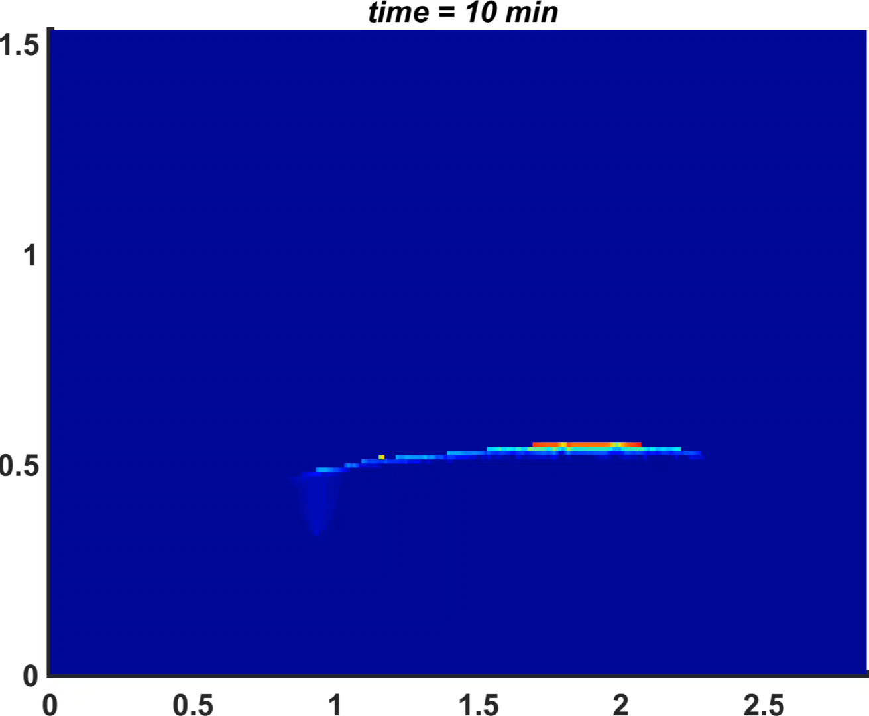

Gas CO₂ Saturation

Slide 2
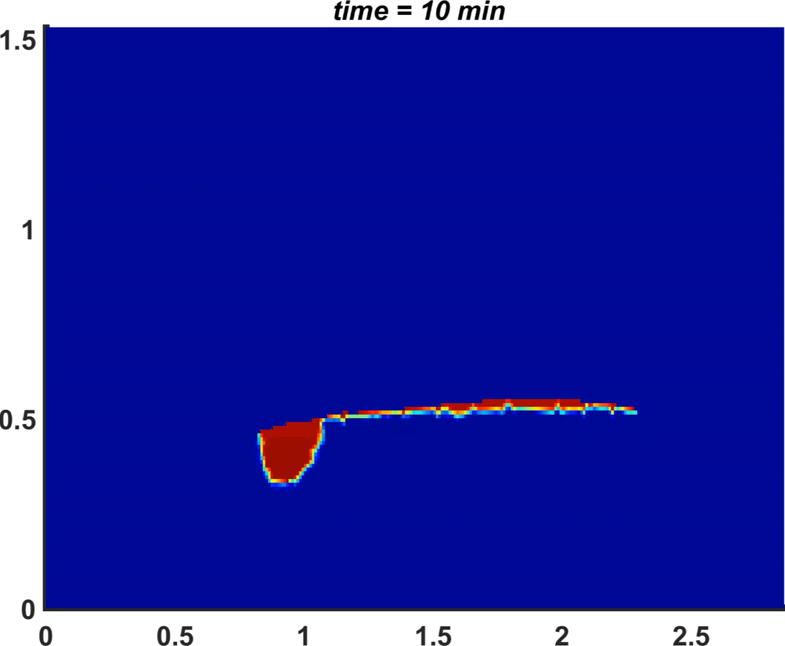

Dissolved CO₂ Concentration (kg/m³)

